Slide 1
Easter Island- Rapa Nui
A Brief Background

Slide 2
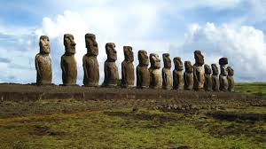
Stone Statues

Slide 3
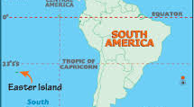
Location- One of the most isolated places on Earth

Slide 4
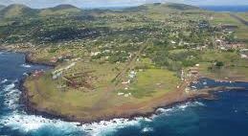
Climate Subtropical, 50 inches rainfall per annum, 66 Sq Miles

Slide 5
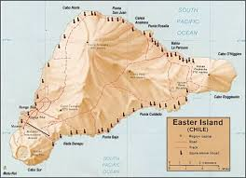
Topography- Rano Raraku Volcano

Slide 6
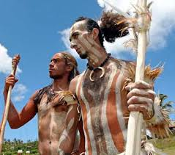
History:
Settled by Polynesians around 900 AD
Because of the southerly latitude
(27 degrees S) causing a cooler climate, many Polynesian crops did not grow.
Colder water- no coral reefs- not as much seafood available

Slide 7
COLLAPSE!
The once thriving societies on Rapa Nui eventually collapsed. How? Why?
You will all be researching how this terrible event happened.
In groups you will be forming “Theories” about what happened and how. What is a theory?

Slide 8
Follow hand out instructions
5 minute presentations

